Slide 1
Regional Patterns in Wildfire Ignition Data
Stat 523 Course Project
Group 8
Abdel-Aziz Sanad

Slide 2
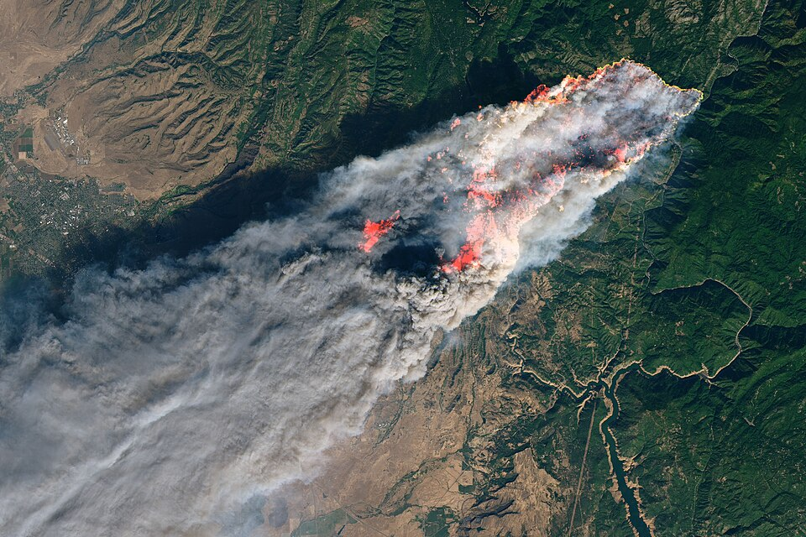
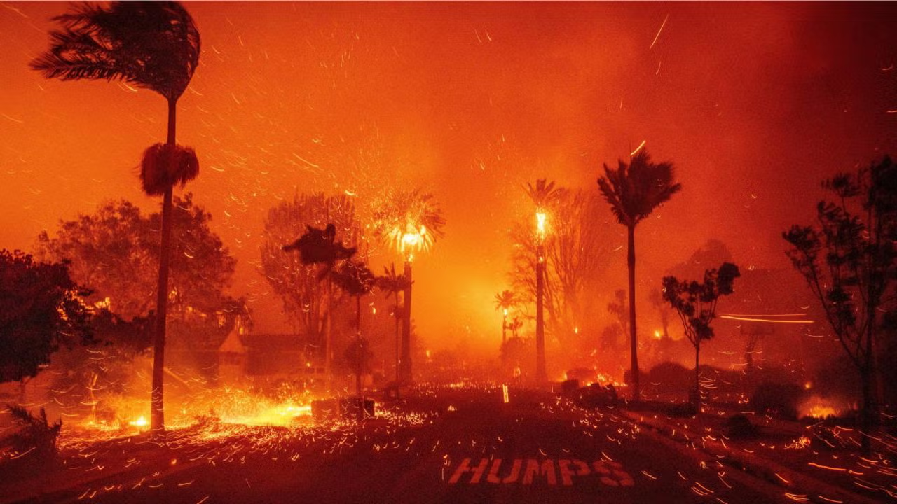
Motivation
Regional Patterns in Wildfire Ignition Data
https://en.wikipedia.org/wiki/Camp_Fire_(2018)
https://sustainablela.ucla.edu/2025lawildfires

Slide 3
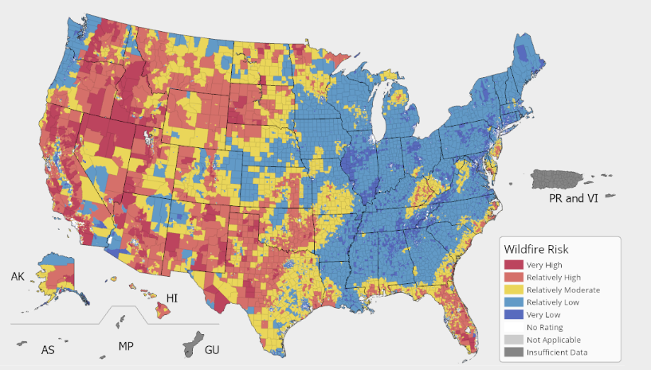
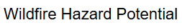
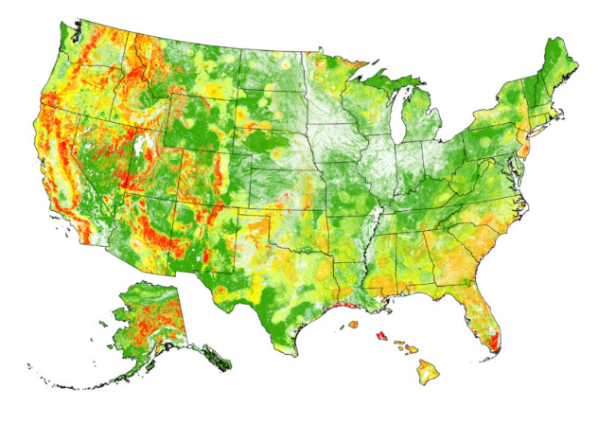
Motivation
Regional Patterns in Wildfire Ignition Data
Wildfire risk maps are commonly used in wildfire risk assessment studies.
https://hazards.fema.gov/nri/wildfire
https://wildfirerisk.org/download/

Slide 4
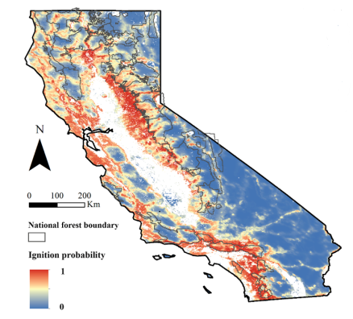
Motivation
Regional Patterns in Wildfire Ignition Data
Wildfire ignition probability models estimate the likelihood of ignition given specific landscape and weather conditions.
Ignition models are typically region-specific.
Trained using limited data.
Generalized ignition models can improve
our understanding of key wildfire ignition
drivers.
Chen, B., & Jin, Y. (2022). Spatial patterns and drivers for wildfire ignitions in California. Environmental Research Letters, 17(5), 055004. https://doi.org/10.1088/1748-9326/ac60da

Slide 5
Motivation
Regional Patterns in Wildfire Ignition Data
The goal of this project is to detect some regional patterns implicit in ignition data.
Ignition data for three different counties are compared.
ANOVA is used to show regional similarities and differences in data.
A better understanding of ignition data and regional patterns helps facilitating the development of generalized ignition models.

Slide 6
Hypothesis
Regional Patterns in Wildfire Ignition Data
Three western counties with high wildfire risk are selected:
Spokane, WA.
Los Angeles, CA.
Butte, CA.
Based on intuition, Los Angeles and Butte ignition data are expected to have similar spatial patterns, and both should be significantly different than Spokane County data.
All three counties are assumed to have similarities in temporal parameters (e.g., ignition weather conditions).

Slide 7
Hypothesis
Regional Patterns in Wildfire Ignition Data
The following tests are performed:
One-way ANOVA and Tukey tests are performed using the county as the factor.
Multifactor ANOVA test is performed including the interaction of additional factors.

Slide 8
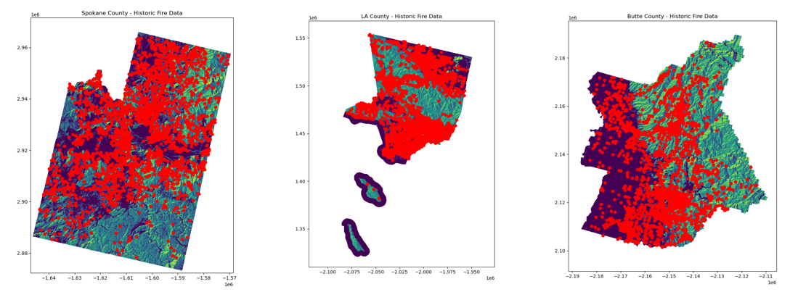
Data
Regional Patterns in Wildfire Ignition Data

Slide 9
Data
Regional Patterns in Wildfire Ignition Data
Ignition data obtained from the US Forest Service (USFS) research data archive:
https://www.fs.usda.gov/rds/archive/catalog/RDS-2013-0009.6
Landscape and human activity data:
https://landfire.gov/data
https://www.fs.usda.gov/rds/archive/catalog/RDS-2020-0060-2
Weather conditions data:
https://www.drought.gov/data-maps-tools/gridded-climate-datasets-noaas-nclimgrid-daily

Slide 10
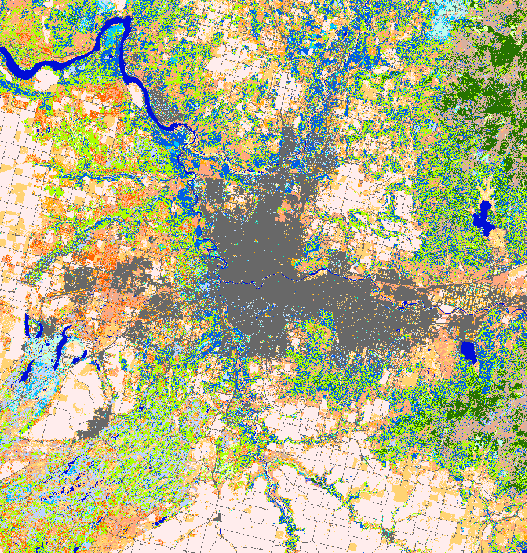
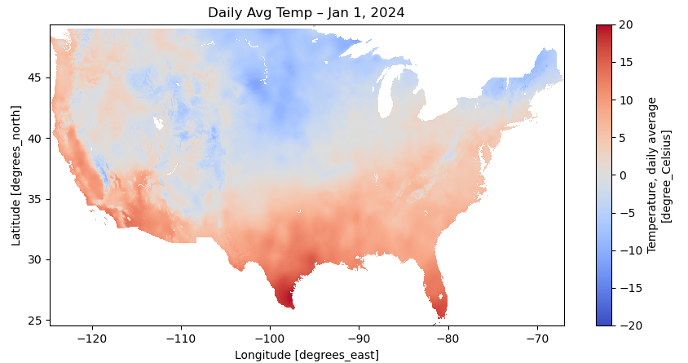
Data
Regional Patterns in Wildfire Ignition Data
Spokane County Fuel Class Map

Slide 11
Data
Regional Patterns in Wildfire Ignition Data
Parameters to test (corresponding to ignition events):
Average daily temperature (weather).
Population density (human activity).
Canopy cover percentage (landscape/vegetation).
Factors:
County name (3 levels: Spokane, LA, and Butte).
Vegetation fuel class (29 levels).
Statistical cause for ignition (2 levels: nature and human).
Distance to the nearest powerlines (8 levels).

Slide 12
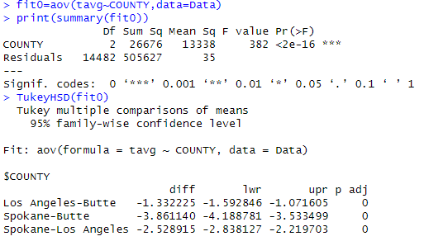
Results
Regional Patterns in Wildfire Ignition Data
One-way ANOVA tests.
Considering the average daily temperature:

Slide 13
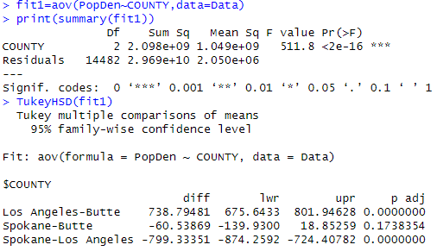
Results
Regional Patterns in Wildfire Ignition Data
One-way ANOVA tests.
Considering the population density:

Slide 14
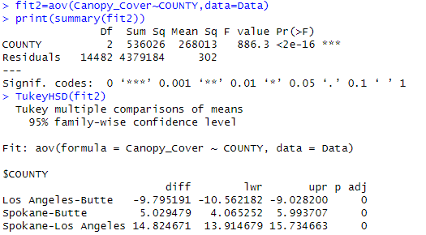
Results
Regional Patterns in Wildfire Ignition Data
One-way ANOVA tests.
Considering the canopy cover percentage:

Slide 15
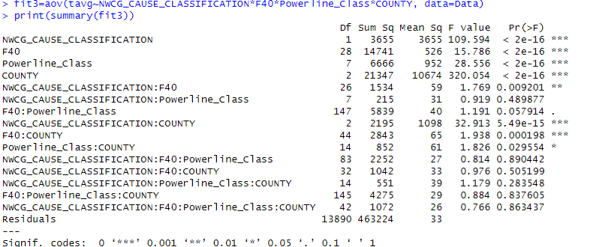
Results
Regional Patterns in Wildfire Ignition Data
Multifactor ANOVA test using the average daily temperature.

Slide 16
Results
Regional Patterns in Wildfire Ignition Data
Multifactor ANOVA test using the average daily temperature.

Slide 17
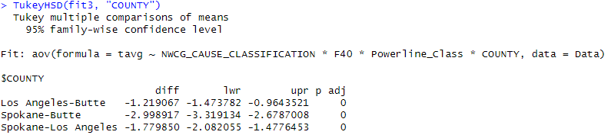
Results
Regional Patterns in Wildfire Ignition Data
Multifactor ANOVA test using the average daily temperature.

Slide 18
Conclusions
Regional Patterns in Wildfire Ignition Data
The county/region had significant effect on the tested ignition parameters (temperature, population density, and canopy cover).
Tukey test showed significant difference between all counties (except for Spokane-Butte when considering the population density).
Multifactor ANOVA showed that the county still has significant effect on the ignition temperature when considering interactions with different factors.
Large scale data investigation is needed with additional explanatory parameters to achieve better generalization of ignition models.

Slide 19
Regional Patterns in Wildfire Ignition Data
Thank You

